Slide 1



Course Selection Information
2025/2026

Slide 2
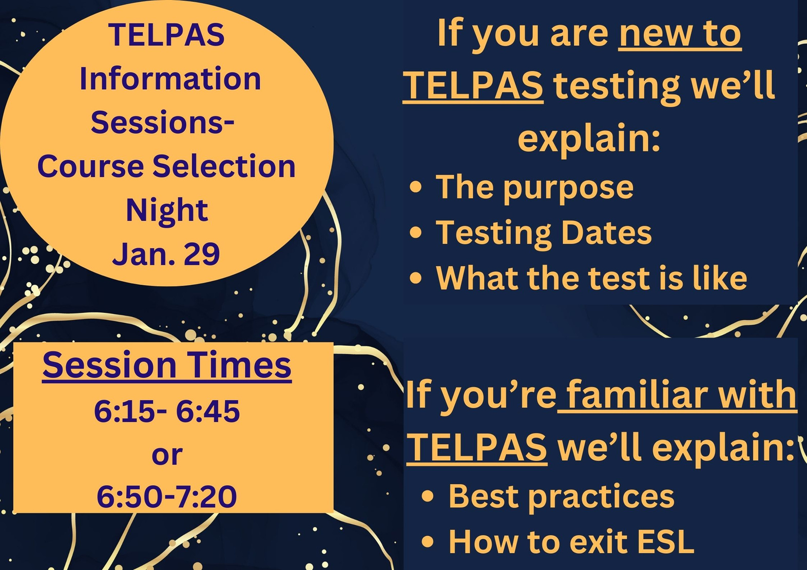

Slide 3


FHS Counselors
A-L Mrs. Abughazaleh
M-Z Mr. Vil
College and Career Facilitator Mrs. Cochren

Slide 4
Course Selection Timeline
12/2024
SchooLinks opens for Parents/Students to start planning
1/16/2025
Legacy Parent Academy: Course Selection Informational Session
1/22/2025
District Course Selection Fair 5:30- 8:00 pm @ the Merrell Center
1/29/2025
Course Selection Fair @ FHS 6:00-7:30 PM
2/12/2025
Course Selections due through SchooLinks
2/14 - 2/28
Student Course Selection Meetings with their Counselor
3/3 - 3/5
Students request changes to their course selection
3/3 - 3/18
Course Verification window on SchooLinks

Slide 5
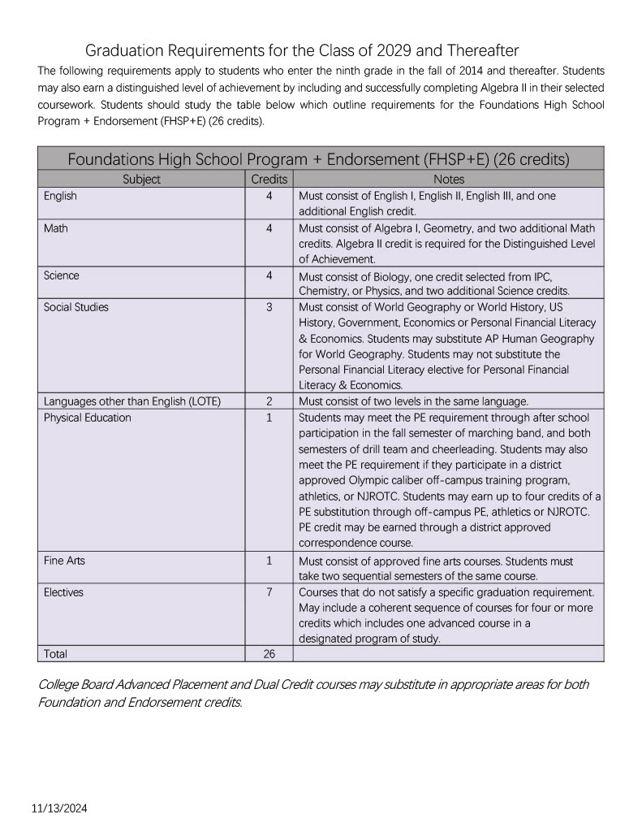
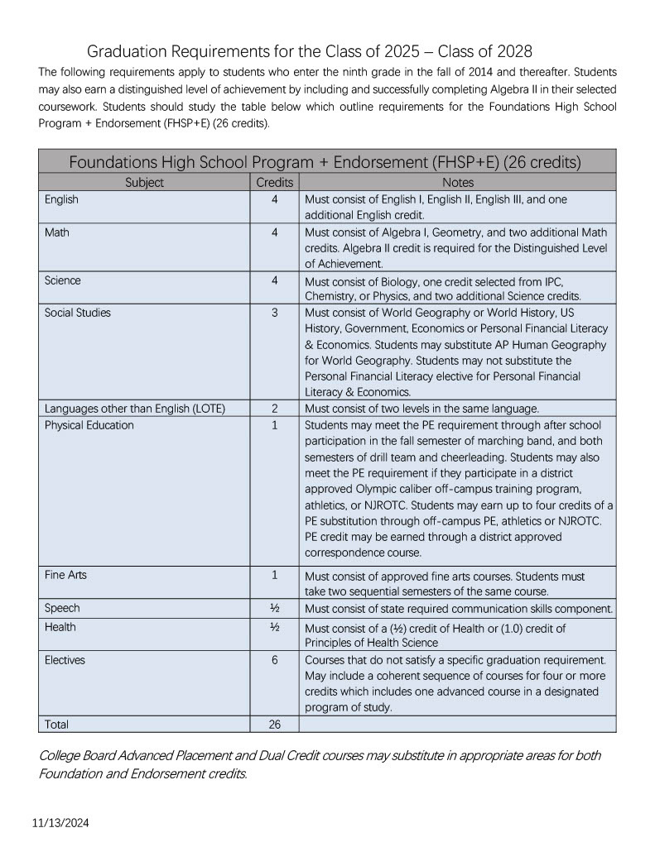
Graduation Requirements

Slide 6
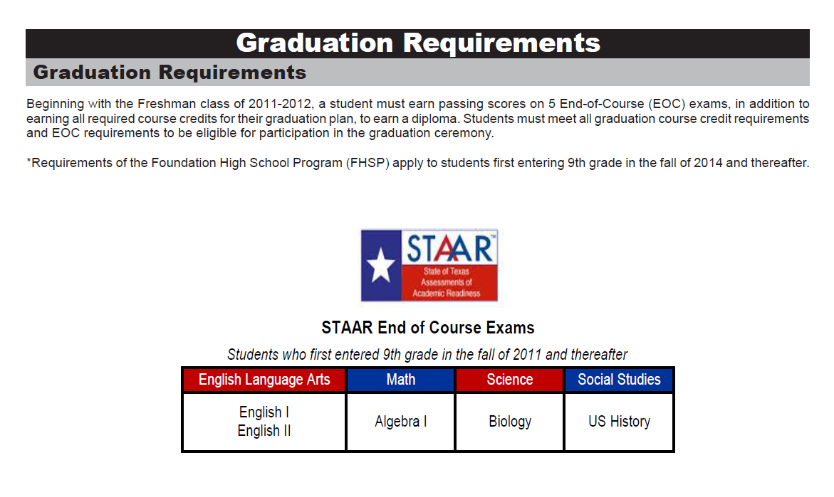
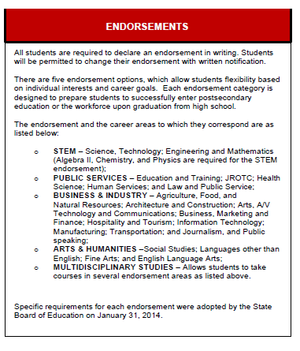
Endorsemets and EOC Requirments

Slide 7

Algebra II is not specified as a graduation requirement; however, students who do not
earn Algebra II credit are not eligible for the following:
• Earning the Distinguished Level of Achievement (DLA), which requires completion of
an endorsement with Algebra II among the four math credits
• Recognition as an honors or high honors graduate
• Automatic admission to a state public college or university
• Certain financial aid opportunities, including the TEXAS grant or the Texas
Educational Opportunity Grant

Slide 8
Distinguished Level of Achievement (DLA)
The Distinguished Level of Achievement (DLA) is earned through successful
completion of:
• All requirements for the Foundation High School Program, plus
• The requirements of at least one endorsement, including
• Algebra II among the four required math credits, and
• A fourth science credit
A student must graduate with a Distinguished Level of Achievement (DLA) to
be considered for the Top 10% and eligibility for automatic admission to a
Texas public college or university.

Slide 9
Top 10% Rule Top 10% Rule:
Top 10% Rule:
UT- Austin Exception
A student whose class rank* is in the top 10 percent of the graduating class maybe eligible for automatic admission consideration at a Texas public college or university.
*Class rank must be based on the student’s rank at the end of the 11th grade, middle of 12th grade, or at high school graduation, whichever is most recent at the college or university’s application deadline.
A student in the Top 10% of the graduating
class is eligible for automatic admission
consideration at Texas public colleges and
universities, with the exception of the
University of Texas at Austin.
*Students who rank in the Top 5%
of their class are eligible for automatic admissions
consideration at the University of Texas at Austin.
Requirements to Qualify for Automatic Admission Consideration:
Complete the FHSP + Endorsement, including the Distinguished Level of Achievement
Earn a satisfactory ACT or SAT score
Submit the application before the college or university’s deadline
Provide a final high school transcript verifying completion of the FHSP + Endorsement, including the Distinguished Level of Achievement.

Slide 10

Choosing Next Year’s Courses
1.Choose or review your endorsement. If you want to change your endorsement, please bring that information to your meeting with your counselor.
2.Choose the core/required classes:
  English
  Math
  Science
  Social Studies
  Choose three additional courses/electives to fill all SEVEN class periods.
  Courses marked (sem) are one-semester courses. If one course marked (sem) is selected, a second is also required.
Every student will meet with their school counselor to review credits and finalize course requests.

Slide 11


Students MUST complete Course Planner in SchooLinks. SchooLinks can be found in MyKatyCloud. Course planner is open now, deadline for course request is Feb 12-2025.
Instructions:
1)List three full credits of alternate choices in order of preference.
2)You cannot repeat a course for which you have already earned credit.
3)Pay close attention to courses that have prerequisites.
4) Please review the course selection smore

Slide 12

Course approval and Schedule Changes
  Katy ISD uses a universal course selection process.
  Course approval is the time to make changes to the course requests. Students and parents are able to request changes to their course selection March 03-05.
  Schedule changes for the 2025-2026 school year will be allowed only in the following cases:
  1. Student has not met course prerequisites;
  2. Student has already earned credit for the course;
  3. Change in program (athletics, fine arts, etc.),with coach/director approval;
  4. Level changes as recommended by the teacher and counselor, with parent and grade level administrator approval within established deadlines; (AP Human→Aca World Geo)
  5. Student did not meet standard on STAAR/EOC exam.
  *Please make selections carefully.*
  NO elective changes will be honored after course approval closes.

Slide 13

What is MCTC?
Miller Career & Technology Center serves as a central site for Career & Technical Education (CTE) courses that are not offered at the student's home campus. Our innovative courses are available to juniors and seniors in Katy ISD and provide them with the opportunity to explore and gain exposure to potential post-secondary options or career experiences.

Slide 14

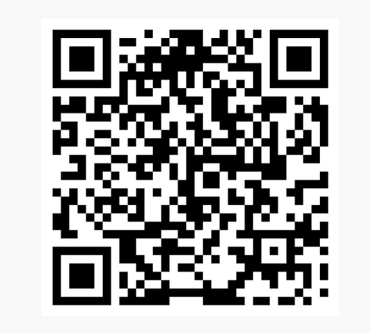
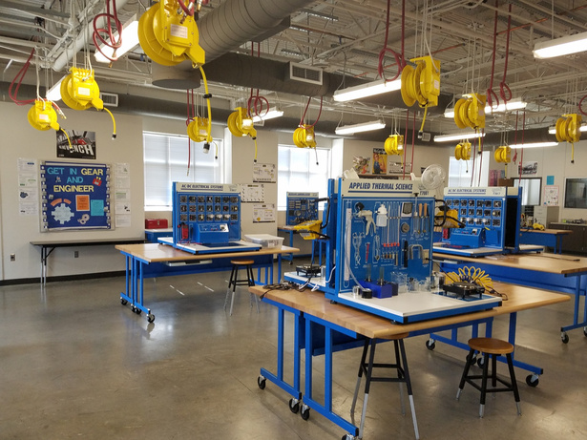
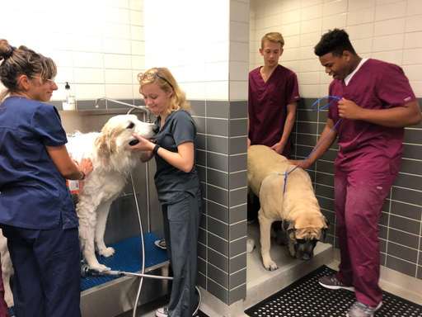
Courses at MCTC
Business & Industry
Architectural Design
Automotive Technology
Cisco Internetworking Technologies
Computer Technician
Construction Trades
Culinary Arts
Cyber Security
Digital Audio
Film
Manufacturing Engineering
Veterinary
Public Services
Clinical Rotation
Cosmetology
Dental Assisting
Education
EMT-Basic
Health Science
Law Enforcement
Legal Studies
Pharmacy Tech
Scan QR to visit program page or visit https://www.katyisd.org/MCTC
STEM
Practicum in STEM

Slide 15
MILLER CAREER AND TECHNOLOGY
Students will choose the courses in their plan in SchooLinks AND request the courses through the Miller tile in their MyKaty Cloud. This tile opens January 27 at 7am and closes February 28 at 11:59pm.
MILLER CAREER CENTER Preview Nights:
Current 9th - 11th grade is Jan 27 from 6:00 to 7:30pm
Current 6th - 8th grade is Feb 24 from 6:00 to 7:30pm

Slide 16
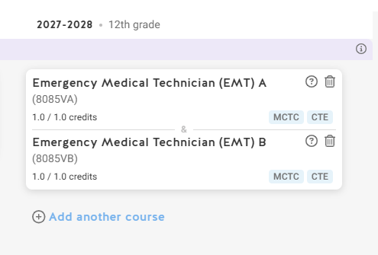
MILLER CAREER AND TECHNOLOGY
  Choose a pathway that you are interested in
  Counselors help plan all prerequisite courses needed for MCTC
  Most MCTC course are two periods, some are three. Plan to be there half of the school day.
  Buses avaliable.

Slide 17
KAP Courses- Katy Advanced Placement
Katy ISD offers KAP courses in language arts, social studies, science and mathematics. Additional options are available in languages other than English, beginning with level III
The goals of KAP are to:
  help students develop academic skills needed for success in AP
  provide an opportunity for students to engage in appropriately challenging coursework in a low-risk environment
  expose students to critical thinking and reasoning tasks intended to build academic stamina (productive struggle)
GPA on 5.0 scale

Slide 18
AP Courses- Advanced Placement Courses
  College level courses- GPA on 5.0 scale
  Strong focus on reading and writing
  A score of 3 or better out of 5 on an AP exam, is often accepted for college credit at several of universities across the nation.
  Courses are available in English, social studies, computer science, mathematics, science, world languages, music theory and art.
  Students are encouraged to verify credits awarded by college through the AP Credit policy on College Board’s Website.
https://apstudents.collegeboard.org/getting-credit-placement/search-policies

Slide 19
What are Dual Credit courses?
  Dual credit is a process that allows a high school student to enroll in a college course and receive simultaneous credit from both the high school and the college.
  Katy ISD high schools partner with Houston Community College to offer a variety of dual credit courses.
    Dual Credit Core Courses:
      Are taught by college faculty or college-approved high school instructors meeting the same standards and requirements of regularly employed college faculty.
      Are transferable to any public college or university in the state of Texas
GPA on 4.5 scale

Slide 20
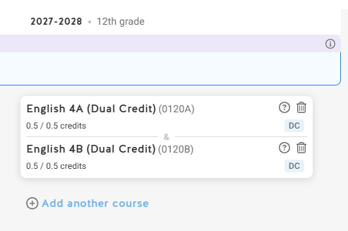
Dual Credit
  New dual credit students have to apply to HCC through the Apply Texas Application portal.
  Students will place the dual credit class on their SchooLinks.
  Current dual credit students are grandfathered in
  Students can take dual credit classes in the summer & during the school year.
  FHS CCF Ms. Helen Cochran will meet with every student to assist with Dual Credit.
  Dual Credit Enrollment is due by March 28th.

Slide 21
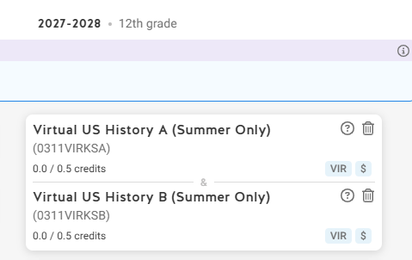
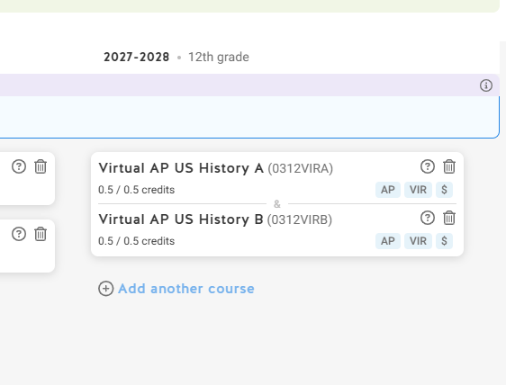
KVS- Katy Virtual School
  KVS is optional, can be taken in the summer, or during the school year.
  If the course has a $ sign on it there is a course fee.
  Course that have VIR are virtual
  Students can choose KVS courses on Schoolinks course planner.
  Student who qualitfy for free or reduced lunch, will have a reduced fee or will take the class for free.

Slide 22
New Course offering models
  Virtual Instructional day REQUESTS- A limited number of courses are offered as a virtual option during the school day.
  Asynchronous learning requires students to learn independently.
    In this format, lessons, assignments, and materials are made available online, and students can access them at their own pace and on their own schedule.
  Students must demonstrate responsibility by using their study hall time effectively to complete coursework.
    This requires self-discipline and time management to ensure all assignments and tasks are finished within the given deadlines.

Slide 23
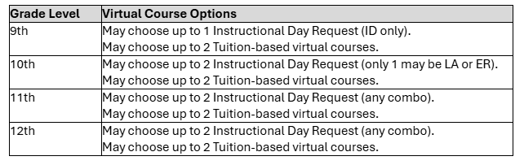
New Course offering models
  During the 7 period HS Day
    Virtual Instruction Day Request (IDR)
    May be combined with a study hall, late arrival, or early release
    Staffed by home campus teachers
  Outside the 7 period HS Day
    The opportunity to take up to 2 additional tuition based virtual courses outside of the school day

Slide 24
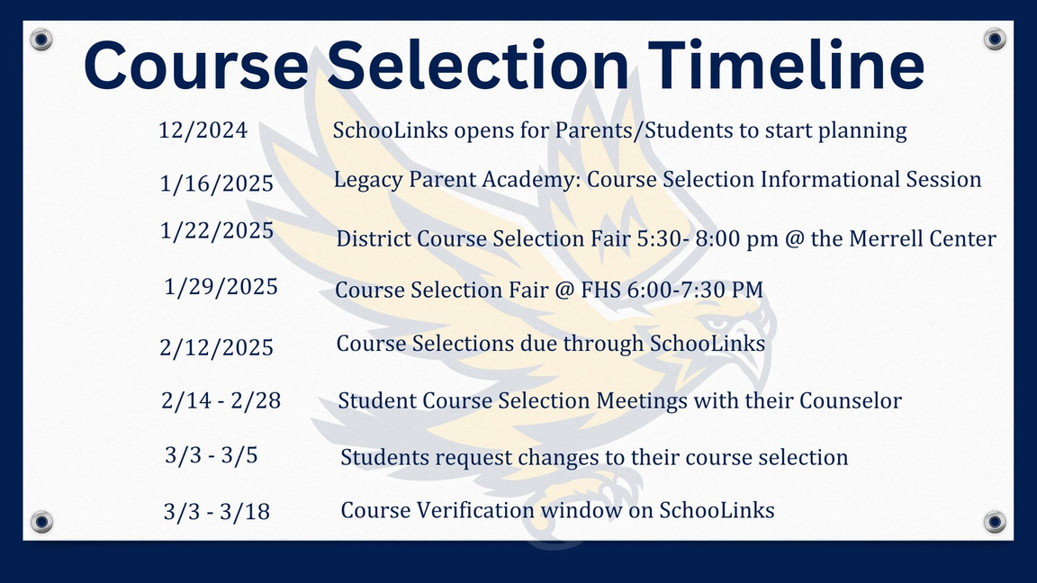

March 05 is the deadline for changes to course
requests. When schedules are published in the
Fall of 2026, the ONLY changes allowed will be
in the following cases:
1. Student has not met course prerequisites;
2. Student has already earned credit for the course;
3. Change in program (athletics, fine arts, etc.),with coach/director approval;
4. Level changes as recommended by the teacher and counselor, with parent and grade level administrator approval within established deadlines; (AP Human→Aca World Geo)
5. Student did not meet standard on STAAR/EOC exam.

Slide 25
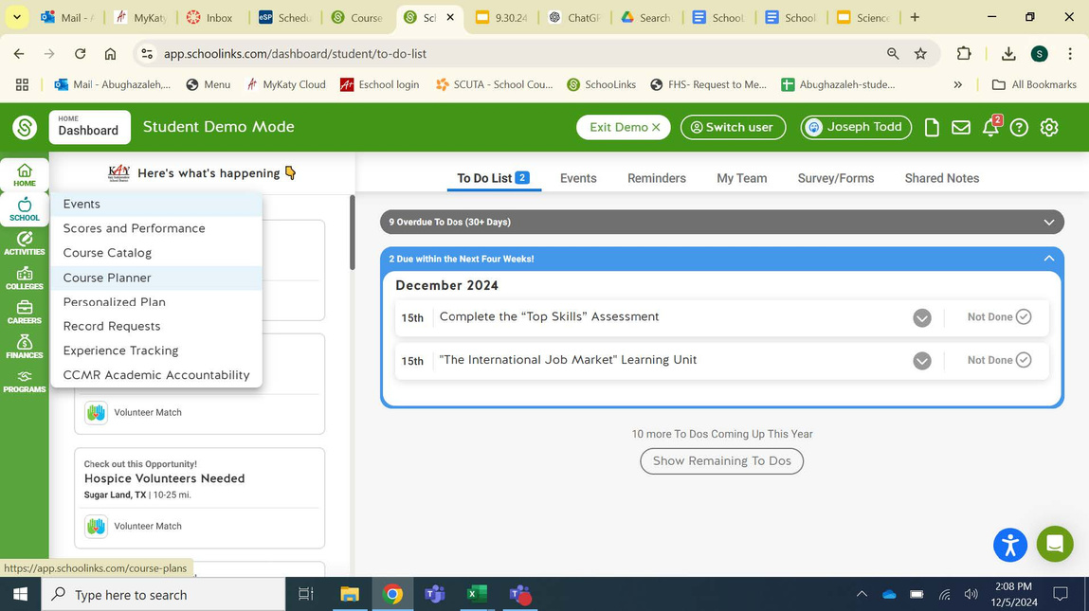
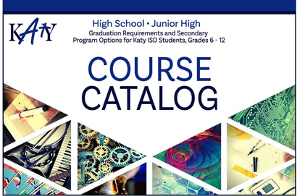


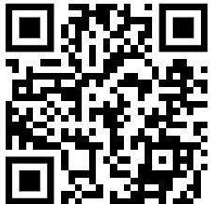
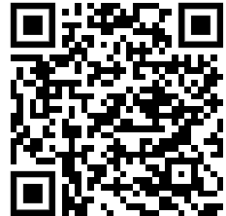
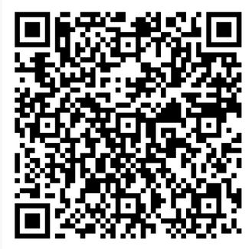
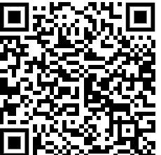
Course selection guides
Course Catalog in Schoolinks- course description
Schoolinks Step by Step Guide
Course Planner Video- Schoolinks
KISD Core and CT Course List

